Slide 1



VLookup Function

Slide 2



What is a VLookup function?
It searches for a value in the leftmost column of a table and returns a value in the same row from a specified column.
Left-to-right only: VLOOKUP can only search for a value in the first column and return data from columns to its right.
Exact vs. Approximate: If you omit the final argument or set it to TRUE, Excel looks for an approximate match and requires your first column to be sorted ascending. Use FALSE to prevent wrong results.

Slide 3

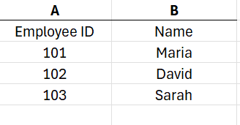
Suppose you have this table:
And you want Excel to automatically return the employee’s name when you type and Employee ID such as 102:
The basic formula structure is:
=VLOOKUP(lookup_value, table_array, column_number, FALSE)

Slide 4



Let's practice!
1. Click the cell where you want the answer to appear, for example E2.
2. Type:
=VLOOKUP(
3. Select the value you want Excel to search for. I this example, that is D2:
=VLOOKUP(D2,
4. Select the table containing the information. Here, the table is A2:B4:
=VLOOKUP(D2,A2:B4,
5. Enter the column number containing the answer you want. The names are in the second column, so enter 2:
=VLOOKUP(D2,A2:B4,2,
6. Enter FALSE because you want an exact match:
=VLOOKUP(D2,A2:B4,2,FALSE)
7. Press Enter.

Slide 5

One important rule: the value you are looking for must be in the first column of the selected table. For most basic VLOOKUP tasks, use FALSE for an exact match.

